Slide 1
Reducing alcohol harms in Ireland 2023: A clinician’s view.
Prof Frank Murray MD

Slide 2
Ireland scorecard in the global alcohol landscape
Ireland has done very well: PHAA 2018
Ireland is potentially stepping backwards: Sale of Alcohol Bill.
No one responsible for alcohol sales and harms Ireland.
No organization responsible for alcohol harms in Ireland.
Voices of patients/others harmed not adequately heard
Little public anger re alcohol harms.
Alcohol treatment services inadequate.
No alcohol clinical programme in HSE.
Irish low risk alcohol guidelines outmoded and not evidence-based.
Awful spectre of childhood drinking and drunkenness in Ireland.
Powerful lobbying of alcohol industry.
Alcohol industry does not pay for the financial costs of alcohol consumption.

Slide 3
Boy (13) drowned while trying to save friend

Slide 4
Boy (13) drowned while trying to save friend
Blood alcohol level 235mg%

Slide 5
Blood alcohol level 161mg%

Slide 6
Public Health (Alcohol) Act, 2018.
Minimum unit pricing (MUP)
Limited regulation of marketing and advertising
Limited regulations of sale, supply and consumption
Separation of alcohol from ordinary commodities
Regulation of sports sponsorship
Health labelling of alcohol products, including cancer warning

Slide 7
MUP in Scotland was associated with a 13% reduction in deaths wholly attributable to alcohol consumption
(95% CI –18·4 to –8·3; p=0·0004)
Wyper GMA et al. Lancet 2023; 401: 1361–70

Slide 8
Hospitalisations wholly attributable to alcohol consumption decreased by 4%
(–8·3 to 0·3; p=0·064)
Effects were driven by significant improvements in chronic outcomes, particularly alcohol-related liver disease

Slide 9
MUP reduced deaths and hospitalisations wholly attributable to alcohol consumption in the four most deprived deciles in Scotland.
Powerful social justice argument for MUP

Slide 10
Sale of Alcohol Bill – a threat to progress

Slide 11
Sale of Alcohol Bill
Easier to get a license
Longer sales hours
Online sales: inadequate protections for underage individuals
Enforcement and monitoring

Slide 12
Relative risk of death from alcohol is dose-related
Lancet 2018

Slide 13
Alcohol use increases mortality

Slide 14
Future years of life lost due to alcohol
Lancet 2018

Slide 15
Low risk alcohol consumption guidelines: Ireland and UK differ. Irish guidelines outdated and not evidence-based.
Ireland
Men 17
Women 11
UK 2016
Men 11
Women 11
884/572 standard drinks per year
Important task to undertake modernization

Slide 16
Standard (alcoholic) Drinks. Most adults unaware! Most underestimate consumption!
Naggin 200ml
Shoulder 350ml

Slide 17
Alcohol consumption in Ireland 2022
806 Standard Drinks per capita >15 years per year
1075 Standard Drinks per drinker per year
i.e. average drinker in Ireland consumes almost twice the UK low risk guideline levels
Low risk limits: 572/884 in Ireland

Slide 18
Annual alcohol use in Ireland is enormous

Slide 19
Who drinks what? Quarter of population consumes three quarters of alcohol!
68% of revenue is from those drinking above guideline levels in England

Slide 20
Consequences of alcohol use in Ireland
15% of Irish population have an Alcohol Use Disorder
4 deaths from alcohol per day, 1547 annually
>11% of health care budget
>€3.7 billion costs to society, likely twice that amount if including harm to others

Slide 21
Alcohol consumption per capita > 15y. Ireland.

Slide 22
Per capita consumption of alcohol 1960-2011: OECD

Slide 23
Children drinking alcohol and getting drunk
A child protection issue
Levels high in Ireland
Widespread acceptance despite recognized harms

Slide 24
Schoolchildren: ever consumed an alcoholic drink in their lifetime

Slide 25
Most children in Ireland have been drunk or really drunk (%) by age 16 or 17 years
(%)

Slide 26
Alcohol use in pregnancy in Ireland
Alcohol consumption in pregnancy: no safe limit
FASD incidence unknown in Ireland, but estimated to be third highest globally by WHO..5%

Slide 27
1547 deaths in Ireland attributable to alcohol
5% of all deaths in Ireland in 2019 were attributable to alcohol
Zubair Kabir

Slide 28
Alcohol consumption per capita > 15y. Ireland.

Slide 29
Death rate due to cirrhosis in Ireland triples

Slide 30
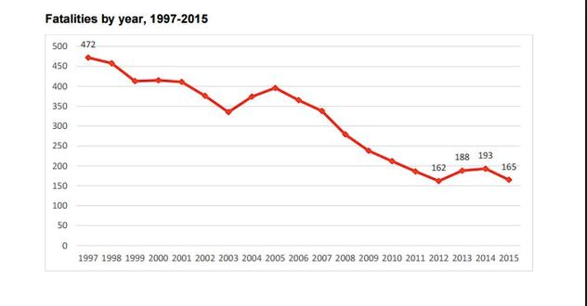
Contrast with road deaths
187 road deaths in 2016
Dramatic fall in
road deaths
Lots of outcry/media coverage
Statutory agency RSA
We need a statutory agency in Ireland responsible for minimizing alcohol harms

Slide 31
The alcohol industry needs to pay for alcohol harms
Not the taxpayer!

Slide 32
Revenue from alcohol taxes is far less than costs of alcohol to society
Healthcare, productivity, mortality.
Income Cost
France 4 billion. 102 billion. (OFDT)
Germany 3 billion. 60 billion. (dhs.de/suechte/alkohle

Slide 34
Effective evidenced–based policies to reduce alcohol harms
Not widely implemented
Implementation defect disorder!

Slide 35
Why is evidence not converted into policy and practice?
Multinational alcohol companies
Vested interests
Ambivalence
Many people want to be able to consume alcohol
Much activity in Ireland around alcohol/pub

Slide 36
European Association for Study of Liver 2023

Slide 37
Reduce population-level alcohol consumption
All European Countries to implement a strategy to reduce alcohol-related harms
Reduce affordability - Minimum Unit Price, Excise duties. Inflation- and effectiveness-linked
Ban on alcohol marketing and sponsorship of sports and events
Licensing system for alcohol sales. Health-oriented.
Enforce drink-driving legislation
Mandatory Health Warnings on alcohol products and mandatory ingredient and nutrition labelling

Slide 38
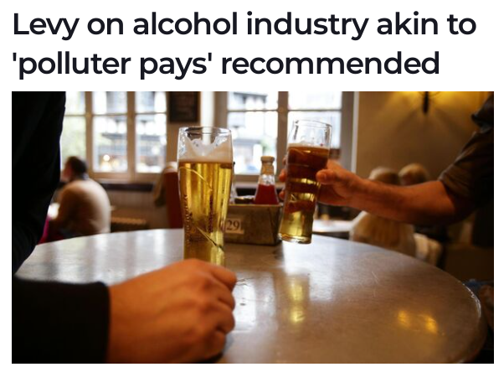
Recoup the cost of alcohol harm from the alcohol industry

Slide 39
EASL recommends
All European countries implement a strategy to reduce alcohol-related harms.
A robust mechanism and infrastructure for the implementation of these measures should be established nationally to ensure effective coordination and independence from the alcohol industry.

Slide 40
Need to focus on gap between evidence and implementation of effective measures to reduce population-level alcohol consumption

Slide 41
Initiatives to consider to reduce alcohol harms in Ireland
Statutory authority to reduce alcohol harms. Like RSA (Road safety Authority)
Break link between alcohol and sport
Focus on reducing children drinking/drunkenness
Levy alcohol industry to pay for downstream costs of alcohol

Slide 42
Thank you

