Slide 1
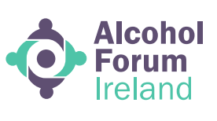
From the bottom up – tapping the power & potential of community action
Paula Leonard, CEO
Alcohol Forum Ireland

Slide 2
Alcohol Forum Ireland
National work
Advocacy, representation, movement building
National lead and support for Community Action on Alcohol
The Irish Community Action on Alcohol Network
Research
The i-Mark Movement: Supporting Communities free from alcohol industry influence
Regional work in the Southern Border Counties
AFI has offices in Cavan, Donegal and Sligo and provides a range of front-line services to all individuals, families and communities affected by alcohol and other drug use in the southern border counties of Donegal, Sligo, Leitrim, Monaghan and Cavan, including
Specialised Family Support for families impacted by alcohol and other drug misuse
Monaghan and Cavan Youth Substance Support (MACYSS)
Alcohol Related Brain Injury Rehabilitation and Recovery support service
Training
Global solidarity
World Assembly on Community Action on Alcohol – founder members in 2022
Eurocare European Alcohol Alliance
Involvement in a number of WHO and GAPA initiaitves

Slide 3
Alcohol in Ireland – A cause for concern?
EVERY PERSON OVER the age of 15 in Ireland drinks, on average, more than 10 litres of alcohol per year (HRB)
10.8 litres of pure alcohol a year – the equivalent of either 40 bottles of vodka, 113 bottles of wine or 436 pints of beer.
While alcohol consumption levels in Ireland have plateaued since 2013, people’s consumption remains “significantly higher” than the government’s 2020 target of no more than 9.1 litres of pure alcohol per person a year.
As one in four people in Ireland don’t drink at all, actual consumption rates among those who do drink would be much higher than this.

Slide 4
88 people die every month in Ireland as a direct result of alcohol
1 in 4 deaths of young men aged between 15-39 is due to alcohol. Alcohol is a factor in over a third of all fatal road accidents
Among people who die by suicide in Ireland, the proportion of those dependent on alcohol - 51% to 85%
National Self-Harm Registry Ireland (NSHRI) - alcohol is involved in one third of all self-harm presentations to ED’s (31%) 17% of adolescent self-harm was attributed to heavy drinking

Slide 5
Rise in demand for treatment? How did we get here? Bad or poor choices of individuals? Lack of self-control? Individual behaviour or changes in the environment?

Slide 6
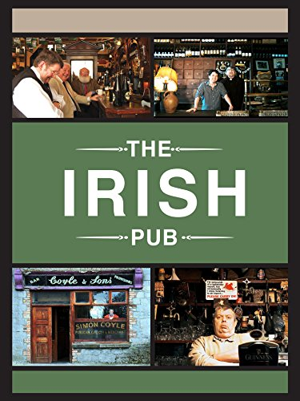
The Irish Pub Archaeological evidence - dates production of beer and wine to Mesopotamia circa 6,000 BC. But, concentrations of ethanol above 5% is very recent. Universally drinking does not happen ‘just anywhere’, usually in designated communal areas or ‘drinking places’ Sociological approaches to alcohol have developed a concept of the pub as a ‘third place’ characterised by conversation, localness, a social leveller, neutral (Oldenburg, 1999)
Watson (2002) : Public houses of one kind or another have been important sites of social, political and economic exchange in almost every type of society.
Ireland has experienced a rapid and significant shift in its ‘drinking places’ and patterns over the past two decades

Slide 7
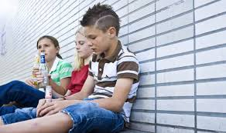
‘Drinking places’ 1998 – 2013 : Pub licenses decreased by 19.1% (10,395 – 8,402) 1998 – 2013 : Wine and spirit off licenses : increased by 377% (1,072 – 5,116) 2015 : Off-licences account for a 62% share of alcohol consumption (increased from 58% in 2013) 2023 report (Uni of Sheffield) alcohol is now almost 70pc more affordable in Irish shops and off-licences than it was 20 years ago (despite introduction of MUP, ROI) Alcohol industry fast moving – emergence of new methods of sale, including drink delivery services

Slide 8
“There comes a point where we need to stop just pulling people out of the river. We need to go upstream and find out why they’re falling in.”
― Desmond Tutu

Slide 9
Reasons why more people are falling into the river?
Price of alcohol
Availability of alcohol
Marketing of alcohol
Alcohol is an addictive substance, sold under license. Not an ordinary commodity

Slide 10
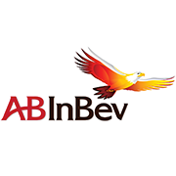
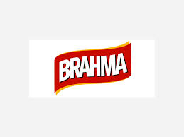
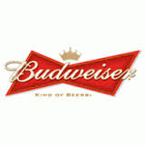
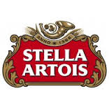
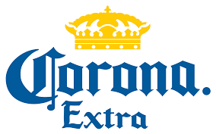
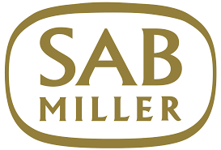
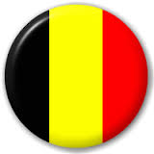
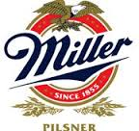
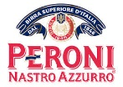
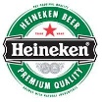
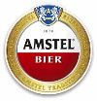
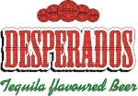
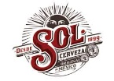
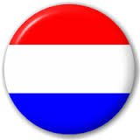
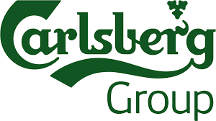
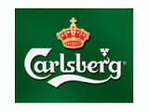
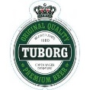
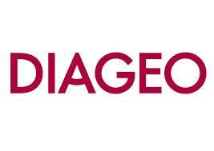
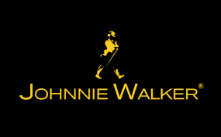
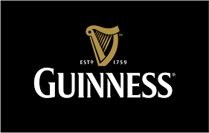
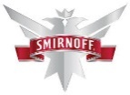
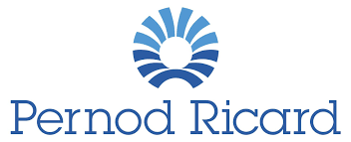
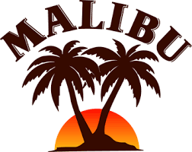
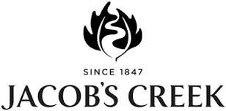
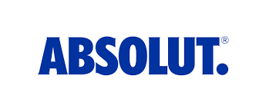
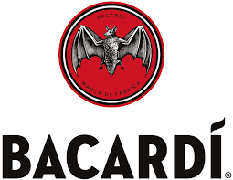
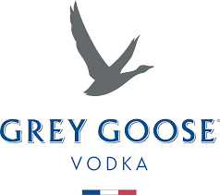
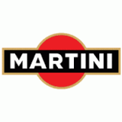
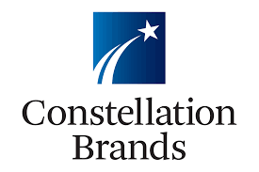
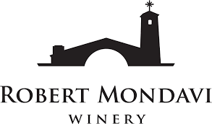
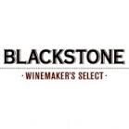
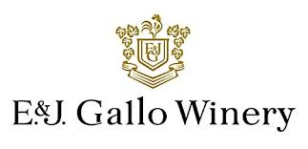
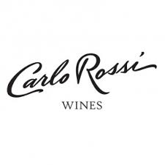
Global alcohol producers: Who are they?
Company | Category | HQ | 2014 Revenue | Major Brands
 | Beer | Leuven, Belgium | £31bn
 | Beer, Cider | London, UK | £15bn
 | Beer | Amsterdam, Netherlands | £14bn
 | Beer, Cider | Copenhagen, Denmark | £6bn
 | Spirits, Beer, Wine | London, UK | £10bn
 | Spirits, Wine | Paris, France | £6bn
 | Spirits | Hamilton, Bermuda | £3bn
 | Wine, Beer, Spirits | Victor, NY, USA | £4bn
 | Wine | Modesto, CA, USA | £3bn
Source: Annual Reports, company websites and press reports (Please note: AB InBev and SAB Miller are treated as separate entities as the details of ‘NewCo’, their merged entity, remain unclear). Annual profits estimated to be in excess of 17 trillion USD
Notes:
Here we can see the impact of globalization on the alcohol industry – the majority of alcohol sold around the world is produced and owned by a small number of companies. This means that global brands have been established as opposed to locally produced products – you can walk into a bar in Moscow, Shanghai or Addis Ababa and order a Budweiser or a Smirnoff vodka.
Global Market Share 2017 by beverage category
Euromonitor International, 2018)
AB Inbev Belgium 6.5% (AB)a 26.8%
Heineken Netherlands 2.8% 10.9%
China Resources Holdings Ltd. China 6.1%
Diageo United Kingdom 10.8% 20.0%
Pernod Ricard France 8.3% 9.7%
E& J Gallo Winery United States 2.5% 3.10%
Constellation Brands United States 2.0% 1.50%

Slide 11
Conflict of interest: the source of alcohol industry revenue
Everyone drinking “in moderation” would mean an extremely large drop in profits (approx. 38%, or £13 billion in the UK
Scenario modelling using descriptive analysis of pooled data from HSE and LCF surveys.
‘moderate’ drinking: below or equal to 14 units per week; ‘hazardous: 15–35 units for women, 15–50 for men; ‘harmful’: 36+ for women, 51+ for men) Source: Bhattacharya A et al. Addiction 2018;113(12):2225-2232
“As with many other markets, the Pareto principle applies: 20% of drinkers account for 80% of sales’ (Scottish Leader Whiskey case study, 2003).
Notes:
This graph shows a breakdown of nature of alcohol consumption in England in 2018. As you can see, most people drink within government guidelines (either blue or green). However, the remaining 25% who consume at hazardous or harmful levels, account for a significant majority of the overall alcohol consumed. And because of that, they account for a significant proportion of the entire revenue for the industry, nearly 70%. This modelling study found that if everyone were to drink in moderation in England, the industry would face a 38% drop in profits, around 13 billion. The industry disputes this interpretation

Slide 12
Very clear from 20+ years of research & evidence what works
WHO Global Alcohol Strategy, launched in 2010 (3 best buys)
2010-2020 has been described as ‘the lost decade’ in terms of turning the tide on spiralling alcohol harm and deaths
2022 – New European Framework on Alcohol (WHO). Community action and involvement of those with ‘lived experience’ recognised as central to how we change the picture of harm.
Challenging the power, influence of the alcohol industry core agenda item right now

Slide 13
Reducing consumption poses a risk to business: The reason the industry tries to get involved
Can allow for policy substitution¹: Funding health information campaigns is used by unhealthy commodity industries (alcohol, tobacco) to replace evidence-based policies with less-effective alternatives^{2,3}
Can give a “health halo” to their activities
Can be a vehicle for misinformation and covert marketing
Can be a ”safe space” that doesn’t inform consumers about unpalatable facts, the role of the industry or effective policy solutions
1. Savell et al. Addiction, 2016;111:18-32; 2. Burton et al. Lancet 2017;15;389(10078):1558-1580; 3. Babor et al. BMJ Open 2018;8:e024325
Notes:
In fact, these conflicts are foundational to why the industry engages in publc health. It is through doing so it can undermine those evidence based approaches that might most constrain business growth, instead focusing on ineffectual arenas for which there is little evidence of effectiveness
PH involvement also boosts legitimacy as a source of PH information, which in turn allows the industry to frame problems and solutions in the mind of the public
It is also part of seeking to position alcohol as a normal, harmless product, and normalize its use

Slide 14
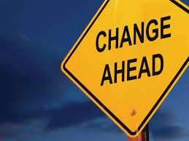
The I-Mark – building a social movement for change
Drinkaware programme removed from school settings in ROI
Building SAFER communities
Campaign to change the provisions of the Sale of Alcohol Bill
Working locally, nationally and globally
Bottom up and top down – we each have a role to play

Slide 15
Alcohol Forum Ireland is an independent Irish charity that provides support, information and services to individuals, families and communities impacted by alcohol harm, while working at the wider level to change Ireland’s problematic relationship with alcohol
AFI offers a range of services including AFI Youth & Family Services, Alcohol Related Brain Injury (ARBI), Community Action on Alcohol, and Education & Training
AFI has offices in Cavan, Sligo and Letterkenny & supports community action on alcohol at a national level
AFI is part of national, European & global networks working to to build safer communities free from alcohol harm

Slide 16
The i-Mark Frame: 6 key strategies of the alcohol industry
Influencing Policy
Misinformation & Confusion Regarding Cancer Risk
Misinformation & Confusion Regarding Risk During Pregnancy
Ineffective ‘Responsible Drinking’ Campaigns
Schools Based Education
Partnerships (with govt., state agencies, civil society, CSR, Funding)
(We acknowledge there are other strategies, and the industry is fast moving & innovative)
Notes:
Pregnancy – may nudge women towards drinking more during pregnancy
Here in Ireland the ‘drink responsibly’ message is embedded in alcohol ads and therefore has a strong association with the positive images used in marketing campaigns.
Responsible drinking’ ‘drink smart’ and ‘drink responsibly’ messages - key focus of the industry’s CSR strategy (used, for example by AB InBev, Diageo, Heineken, Carlsberg). These unscientific & ambiguous terms fail to define lower-risk drinking and are not supported by scientific research. Campaigns produce a positive image of the industry among adolescents and young adults.

Slide 17
So what is the i-Mark?
I-Mark membership commitments. We the undersigned pledge to:
Review any partnership or funding proposals against the questions outlined in the I-Mark toolkit
Never accept funding from, or enter into partnerships with, the alcohol industry, its subsidiary companies, trade organisations, its funded charities or social aspect public relations organisations (SAPRO’s)
Never use or promote alcohol industry funded materials or programmes in either educational or out of school settings with young people
Scrutinise, challenge and raise awareness of the tactics of the alcohol industry in undermining public health in Ireland and beyond

Slide 18
A considerable reach?
The i-Mark has already been successful, it has shown us that the influence of the industry is not inevitable’ – Professor Tom Babor
The i-Mark – referenced in the BMJ, the Lancet and the Journal of Alcohol & other Drug Studies
Project has been presented at the World Assembly on Community Action on Alcohol, the European Alcohol Policy Conference, a WHO PHAO event and ICAAN have delivered training to colleagues in Scotland, Australia, South America, Africa
Invitation to present to the Global Alcohol Policy Conference in Cape Town in Oct 2023
Successful campaign on alcohol industry funded education in schools
Here in Ireland, the movement continues to grow! Welcomed our first NI members (ARC) earlier this year

Slide 19
Doing what works – Building SAFER Communities
2018 – WHO launched the SAFER initiative with the UN United Nations – package to support Member States in reducing the harmful use of alcohol by strengthening the ongoing implementation of the Global strategy
The technical package - focuses on 5 key alcohol policy interventions that are based on accumulated evidence of their impact on population health and their cost-effectiveness.
Working with DOH, a high level steering group and WHO European Regional Office to deliver ‘ Building SAFER Communities’ in 12 sites across Ireland over next three years.

Slide 20
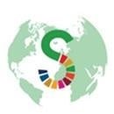
Strengthen restrictions on alcohol availability
enforcing restrictions on commercial or public availability of alcohol through laws, policies, and programmes are important ways to reduce harmful use of alcohol. Such strategies provide essential measures to prevent easy access to alcohol by young people and other vulnerable and high-risk groups.
Enforce bans or comprehensive restrictions on alcohol advertising, sponsorship, and promotion
Bans and comprehensive restrictions on alcohol advertising, sponsorship and promotion are impactful and cost-effective measures. Enacting and enforcing bans or comprehensive restrictions on exposure to them in the digital world will bring public health benefits and help protect children, adolescents and abstainers from the pressure to start consuming alcohol.
Raise prices on alcohol through excise taxes and pricing policies
Alcohol taxation and pricing policies are among the most effective and cost-effective alcohol control measures. An increase in excise taxes on alcoholic beverages is a proven measure to reduce harmful use of alcohol and it provides governments revenue to offset the economic costs of harmful use of alcohol.
Advance and enforce drink driving counter measures
Road users who are impaired by alcohol have a significantly higher risk of being involved in a crash. Enacting and enforcing strong drink-driving laws and low blood alcohol concentration limits via sobriety checkpoints and random breath testing will help to turn the tide.
Facilitate access to screening, brief interventions and treatment
Health professionals have an important role in helping people to reduce or stop their drinking to reduce health risks, and health services have to provide effective interventions for those in need of help and their families.

Slide 21
Join the movement for change. Be the movement for change.
paula@alcoholforum.org
Thank you!

