Slide 1
Alcohol use among children and young people in Ireland
Prevalence, trends, risk & protective factors
Anne Doyle

Slide 2
Presentation outline
Health Research Board – what we do
Young people and substance use overview
Youth drinking in Ireland
Risk and protective factors associated with substance use
Responses

Slide 3
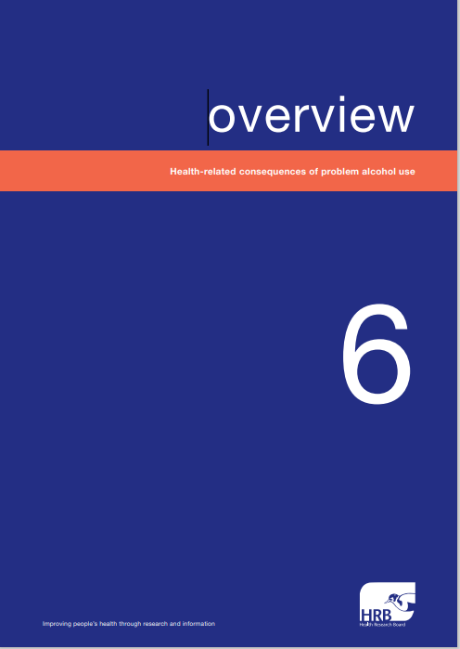
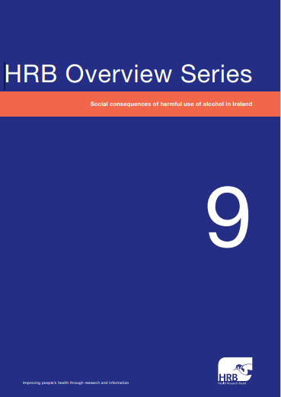
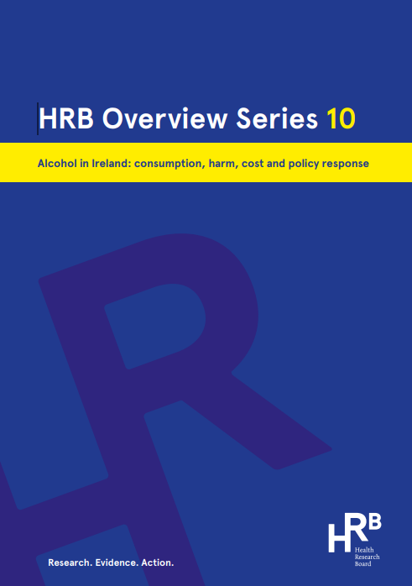
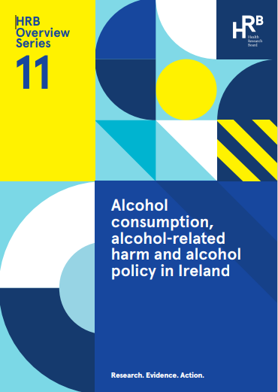
Health Research Board (HRB)
Who we are & what we do
HRB is a State Agency under the Department of Health
We periodically publish overviews on the alcohol situation in Ireland;
how much we drink
how we drink
consequences of alcohol use
tracks trends
international comparisons
Informs the Department of Health

Slide 4
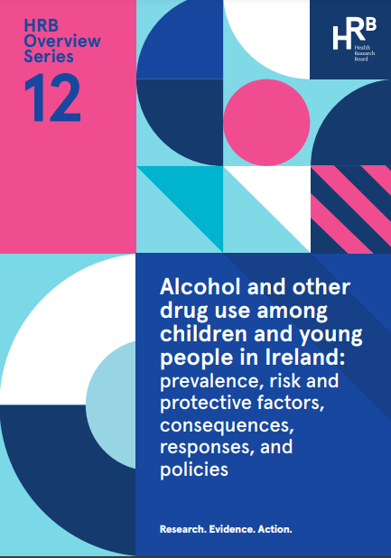
Alcohol and other drug use among children and young people
Alcohol use
Drug use
Risk and protective factors
Consequences
Responses
Policy and legislation governing alcohol and other drug use

Slide 5
Youth drinking in Ireland

Slide 6
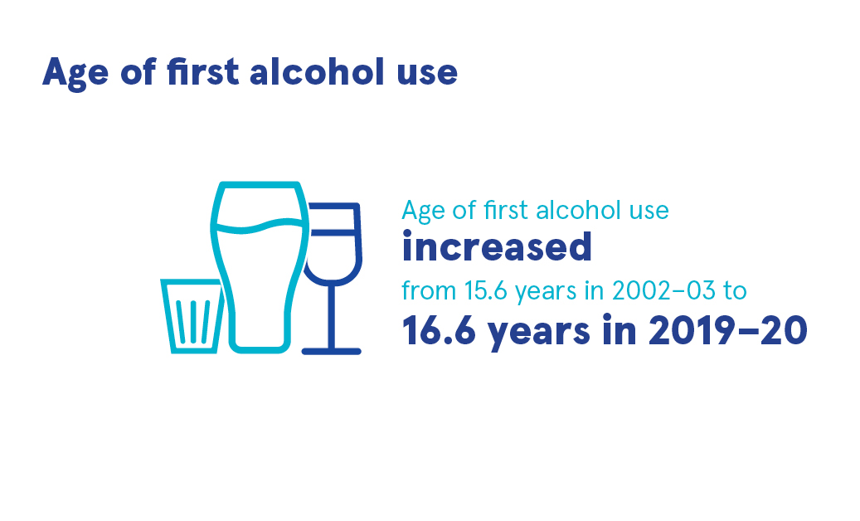
Alcohol use among children and young people
Source: National Drug and Alcohol Survey (NDAS)

Slide 7
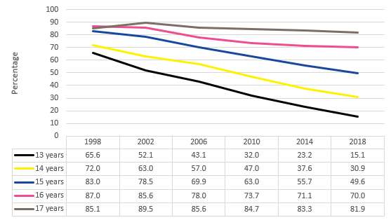
Lifetime alcohol use among 13—17-year-olds
Source: Health Behaviour in School-aged Children (HBSC)
Notes:
decline

Slide 8
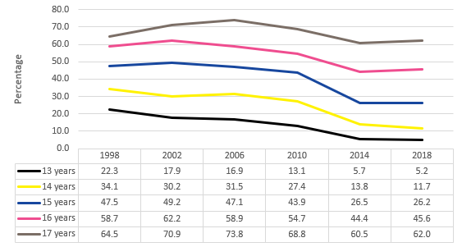
Reports of being drunk in lifetime 13—17-year-olds
Source: Health Behaviour in School-aged Children (HBSC)
Source: Health Behaviour in School-aged Children

Slide 9
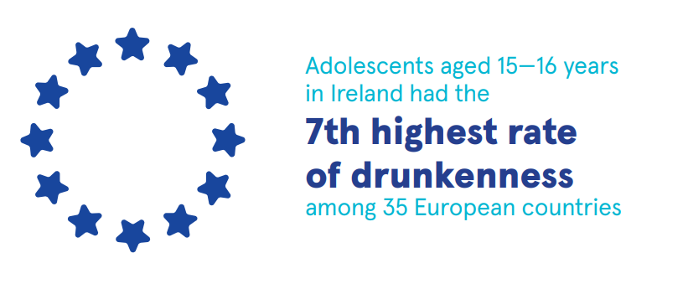
Source: European School Survey Project on Alcohol and Other Drugs (ESPAD)

Slide 10
Alcohol use contributes to all the leading causes of death for young people
suicide
road traffic collisions
poisoning
assaults
seven types of cancer
cardiovascular disease
liver disease
Source: Griswald et al., 2018, Rehm et al 2017

Slide 11
Risk and protective factors

Slide 12
Risk and protective factors
Personal or individual factors
Familial factors
Social factors (school, peers, community)
Attitudes, perceived risks, availability & advertising/marketing

Slide 13
Personal factors

Slide 14
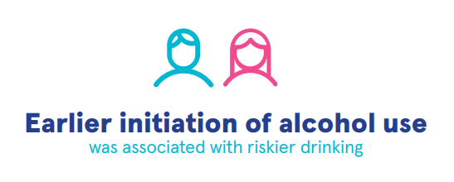
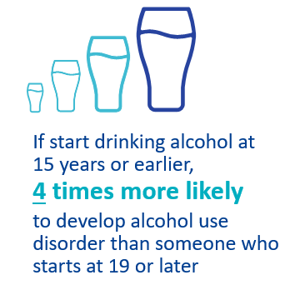
Personal factors
Age of initiation
Sexual orientation
Personal characteristics

Slide 15
Familial factors

Slide 16
Familial factors – risk
Family composition
Parental conflict/violence in the home
Parental attitudes to alcohol use
Adolescents who hang out unsupervised at a friend’s home regularly are almost 4 times more likely to have been drunk in the last month
Source: Planet Youth
Notes:
Parental provision of alcohol
Parental alcohol use

Slide 17
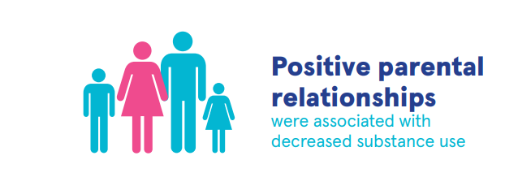
Familial factors – protective
Family support
Parental monitoring

Slide 18
Social factors

Slide 19
Social factors
Socioeconomic factors
Peer substance use
Adolescents who reported that their friends get drunk were more likely to drink alcohol
Source: Planet Youth

Slide 20
Social factors – school experiences
Grades
Skipping school
Leaving school early
Adolescents with negative attitude to school more likely to report being drunk in lifetime/last month
Source: Planet Youth

Slide 21
Social factors – community
Sports/physical activity
Participation in music, art, drama or dance

Slide 22
Attitudes, perceived risks, availability and advertising/marketing

Slide 23
Attitudes, perceived risks, availability
½ young people don’t perceive a great risk in binge drinking
(National Drug and Alcohol Survey, 2021)
Alcohol widely used and acceptable – associated with having fun
(North Inner City Drug and Alcohol Task Force, 2015)
1-in-5
15-year-olds: ‘easy’ to buy alcohol where they live and go to school
(HBSC, 2020)

Slide 24
Exposure to alcohol marketing
2020 Six Nations Championship – alcohol reference every 15-16 seconds (Purves & Critchlow, 2021)
98% of #alcohol videos on TikTok portrayed alcohol in positive light (Jernigan & Ross, 2020)
61% of schoolchildren own alcohol-branded merchandise (Fox et al, 2015)
58% of 18-24-year-olds support banning alcohol advertising on TV before 9pm (Alcohol Action Ireland, 2021)

Slide 25
Policy and legislation responses

Slide 26
Policies and legislation responses
Alcohol prevention programmes
Public Health (Alcohol) Act 2018
National Drugs strategy
Intoxicating Liquor Act 1927 (sales, licenced premises, public places)
Road Traffic Act 1961 (drink driving)

Slide 27
Conclusion
Not all young people who experience risk factors drink alcohol
Programmes need to be tailored to those at increased risk
All alcohol research contributes to a body of evidence
Inform decision-making/policy/service delivery
Monitoring the impact of Public Health (Alcohol) Act
Consider responses to proposed legislation (Sale of Alcohol Bill, 2022)

Slide 28
Thank you! adoyle@hrb.ie X (Twitter) @amcdoyle www.hrb.ie www.drugsandalcohol.ie (National Drugs Library)

